Slide 1


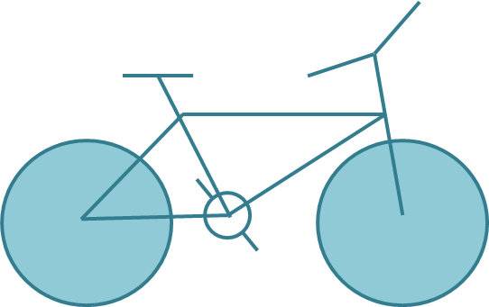
Homework
Draw the following graphics using canvas:

Slide 2
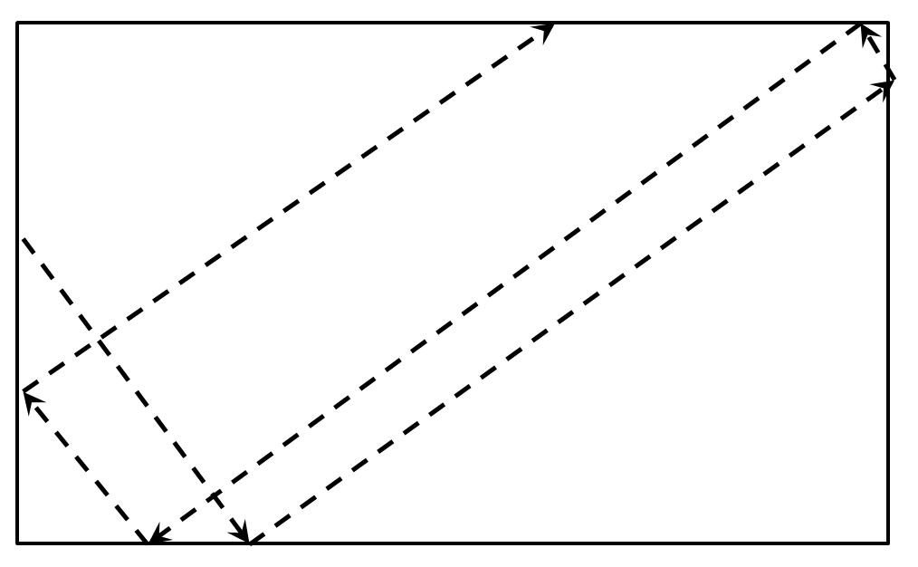
Homework (5)
Draw a circle that flies inside a box
When it reaches an edge, it should bounce that edge

Slide 3
Homework (7)
*Create the famous game "Snake"
The snake is a sequence of rectangles/ellipses
The snake can move left, right, up or down
The snake dies if it reaches any of the edges or when it tries to eat itself
A food should be generated
When the snake eats the food, it grows and new food is generated at random position
Implement a high-score board, kept in localStorage

